Slide 1
Introduction

Slide 2

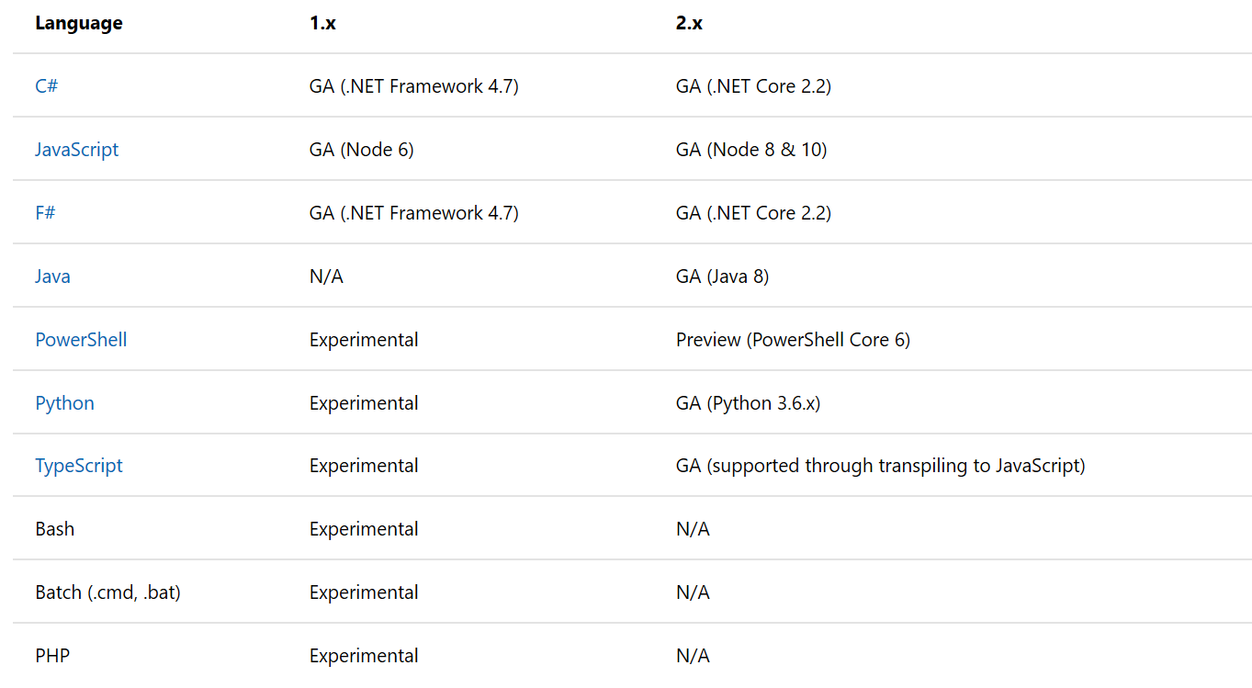
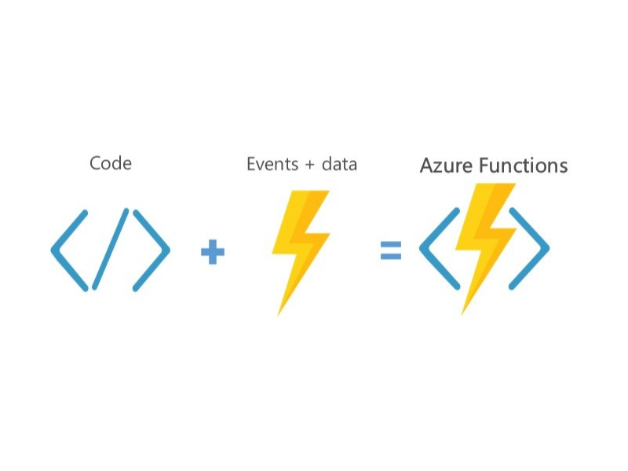
Azure Functions
Small pieces of code
Event driven
Triggers and bindings
Portable (V2)
Many languages
Many hosting options

Slide 3



What Kubernetes / AKS
First Docker: Create, deploy and run applications in Containers
Kubernetes (k8s): open source container orchestration engine for automating deployment, scaling, and management of containerized applications.
Azure Kubernetes Service (AKS): Managed Kubernetes in Azure

Slide 4
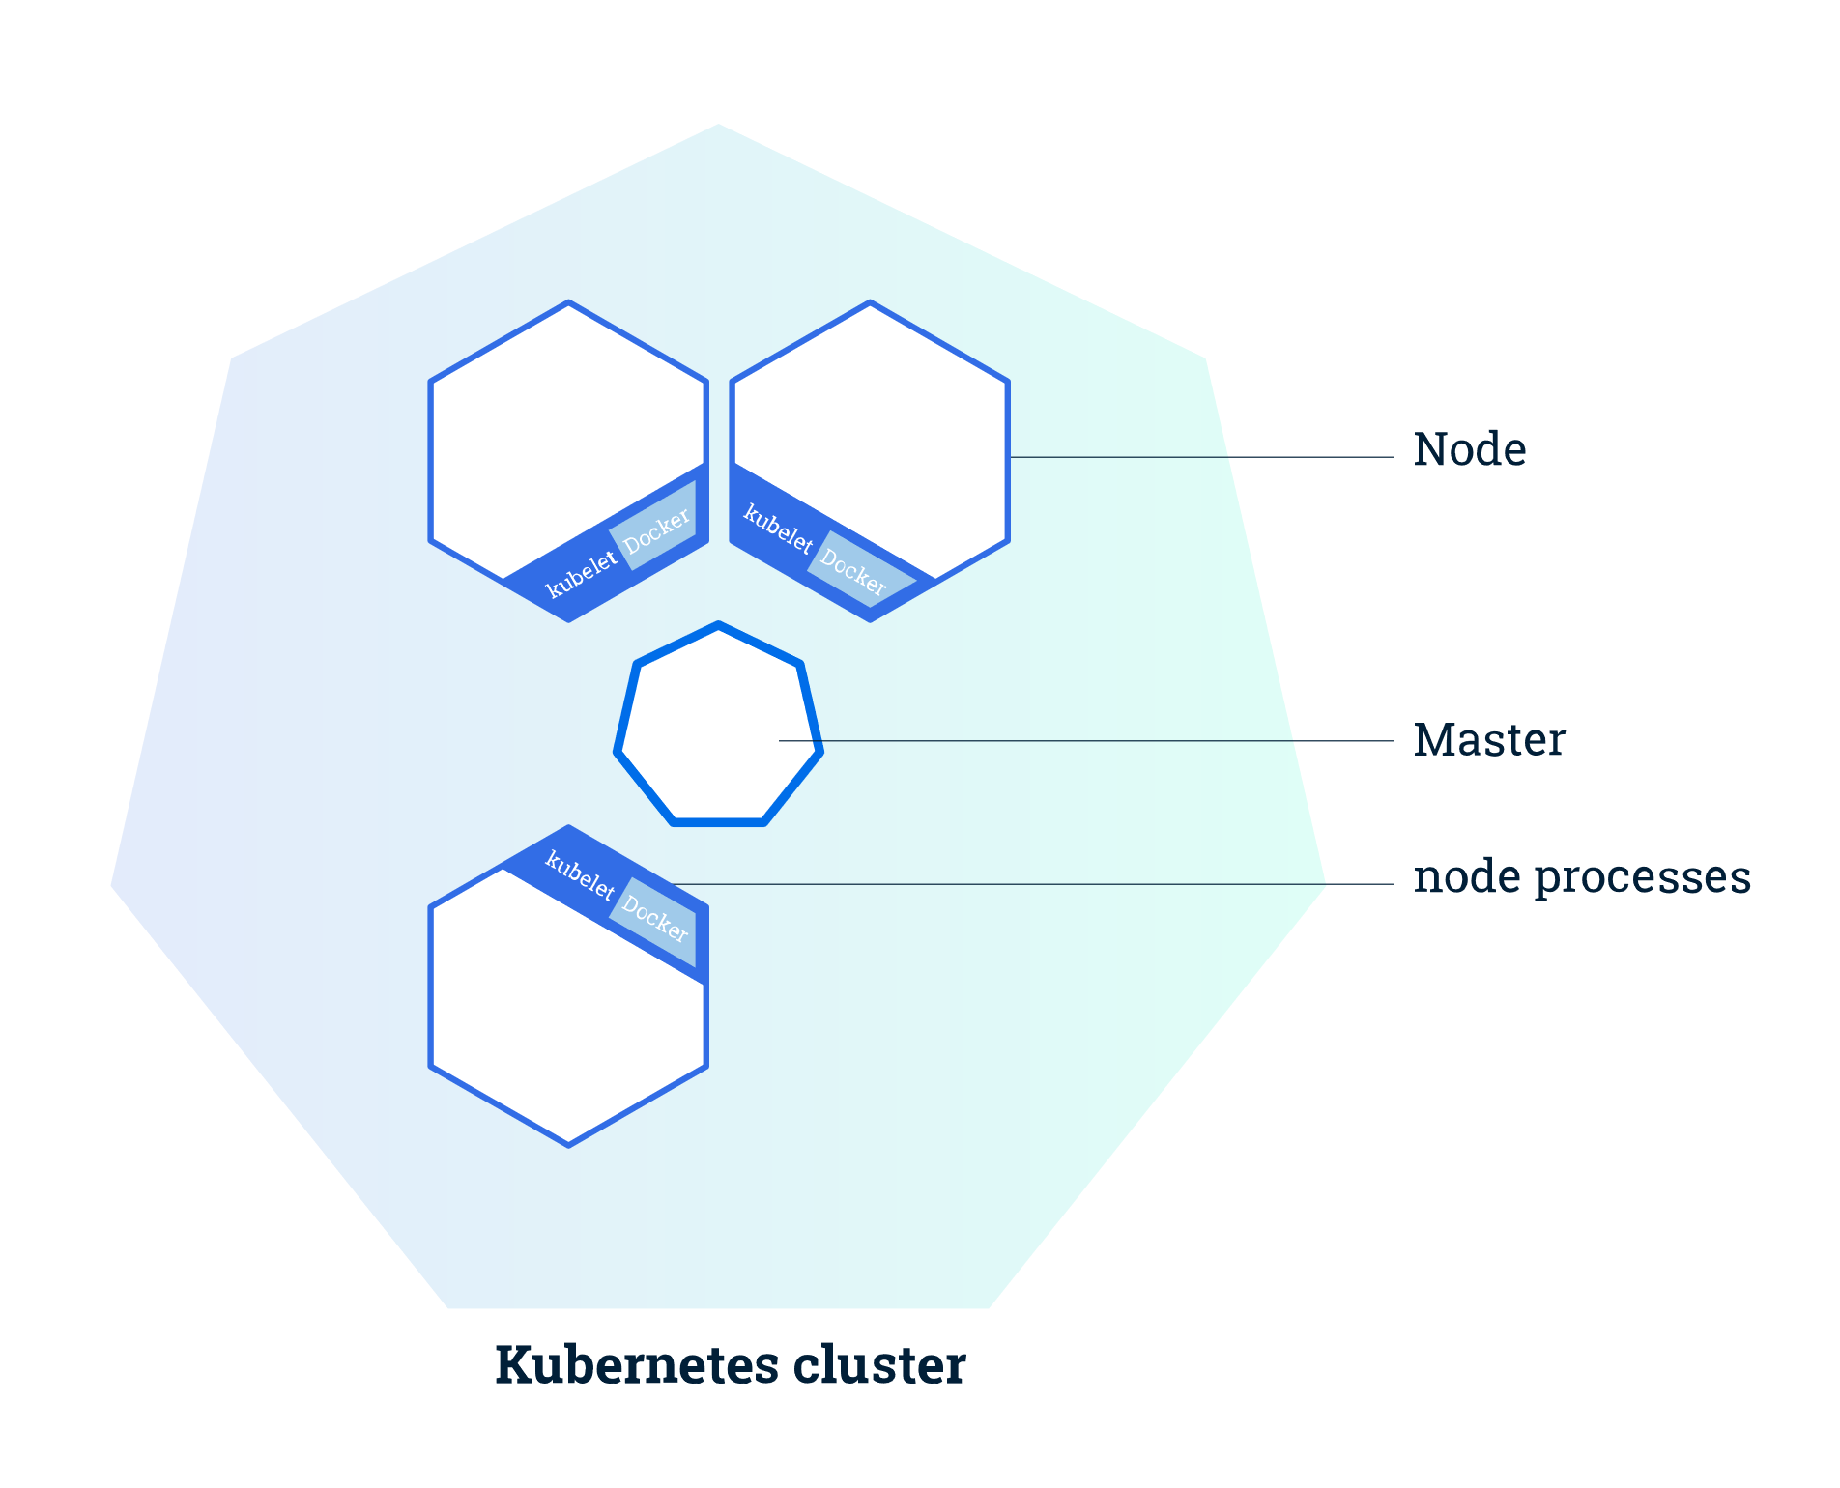
Cluster
Master
Nodes

Slide 5
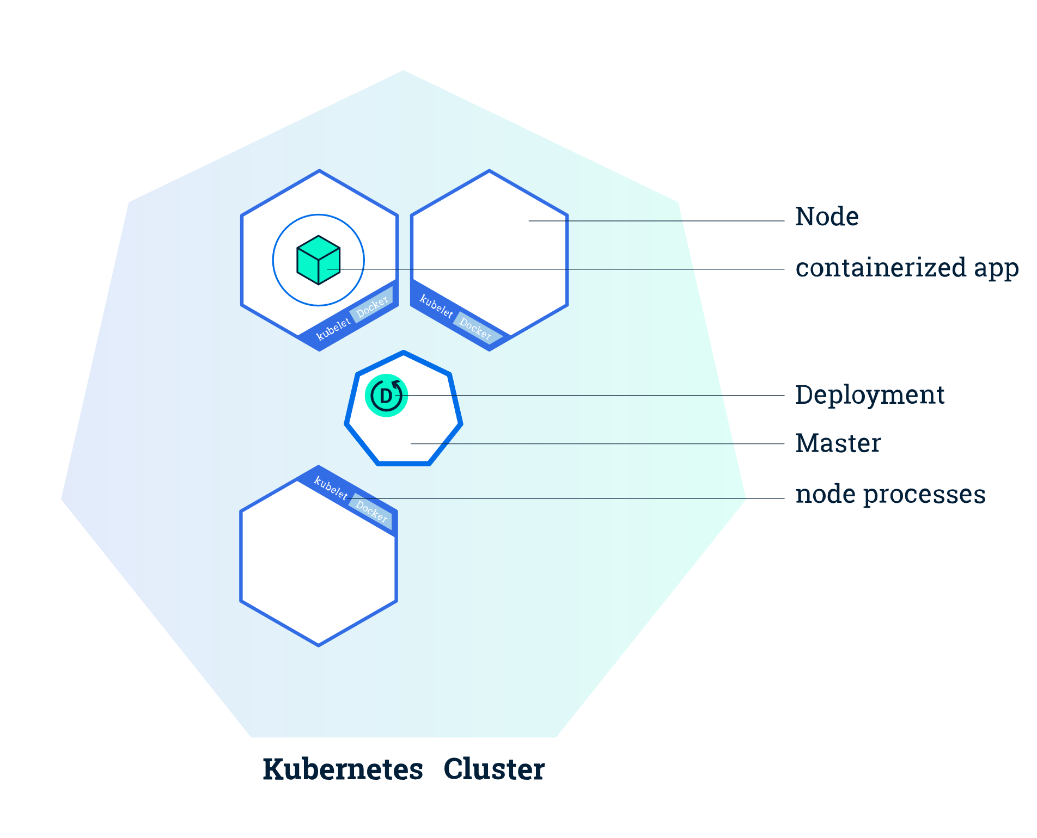
Deployments
Manages lifecycle of app
Across nodes

Slide 6
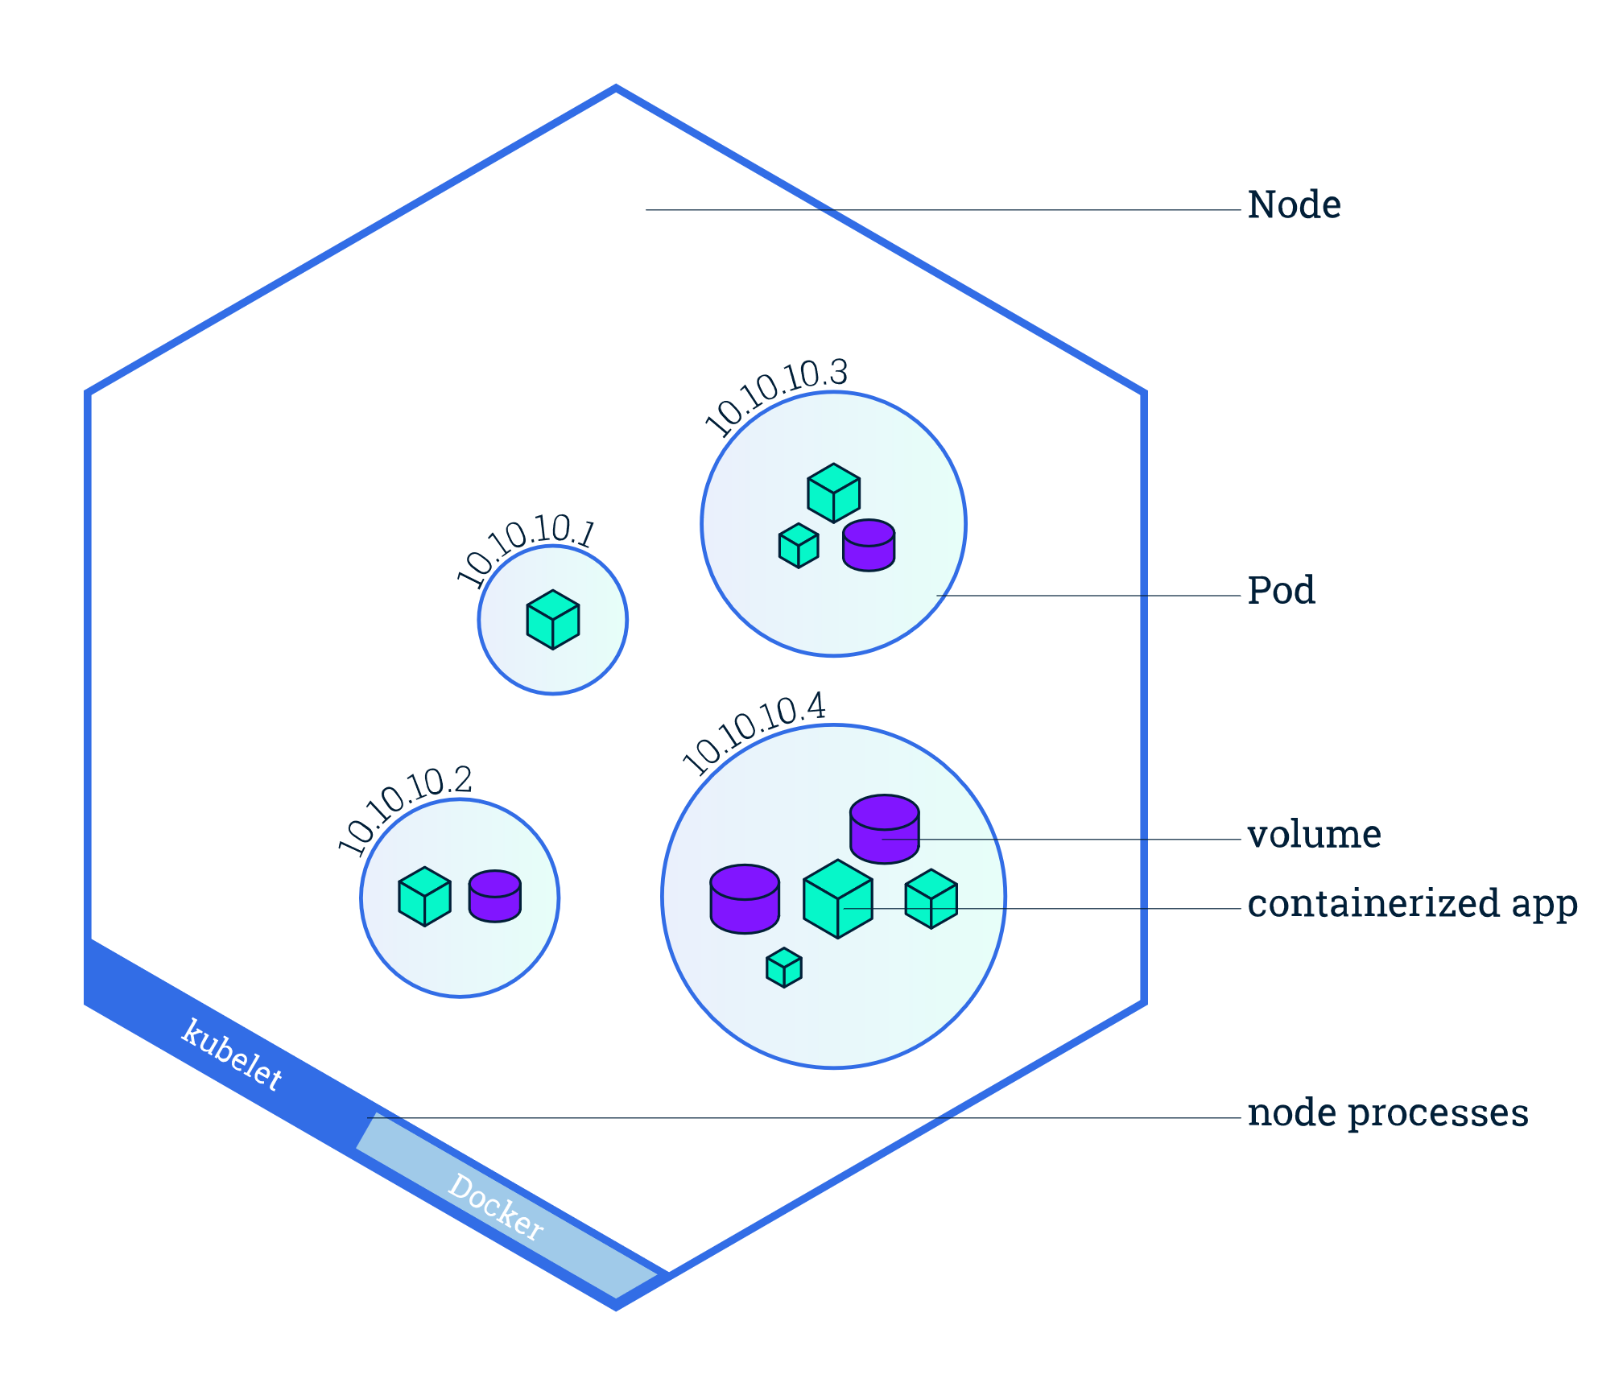
Pods
Unit of Deployment
One or a few Containers
Persistent volumes

Slide 7
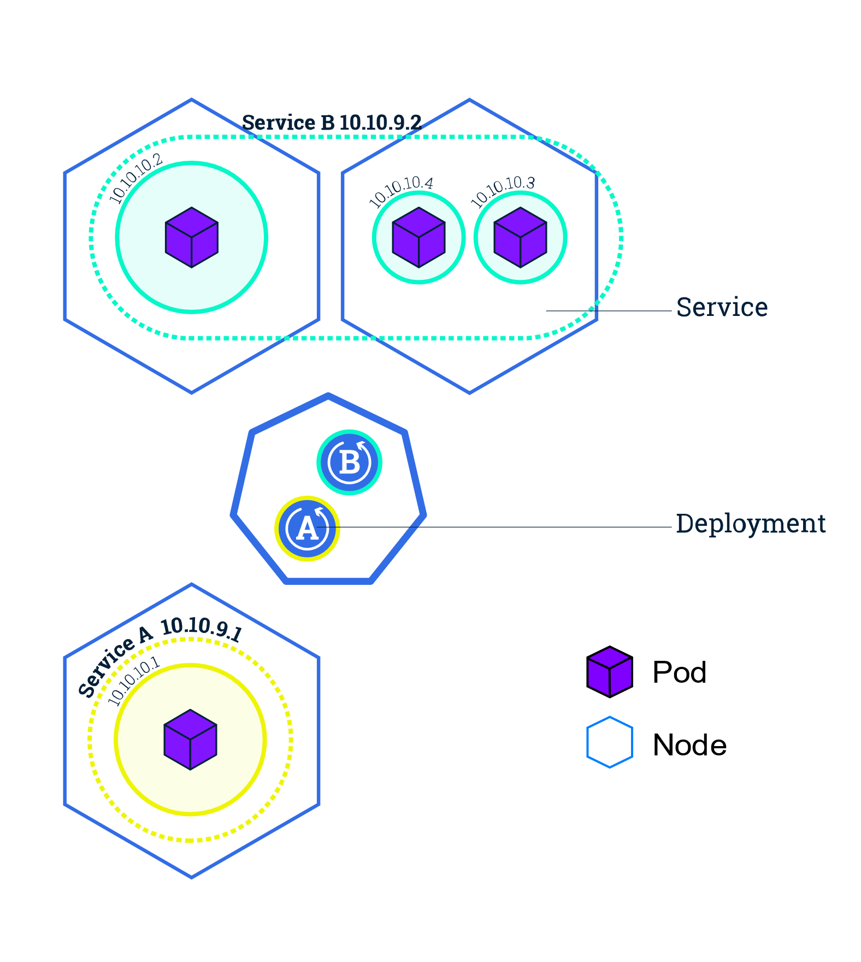
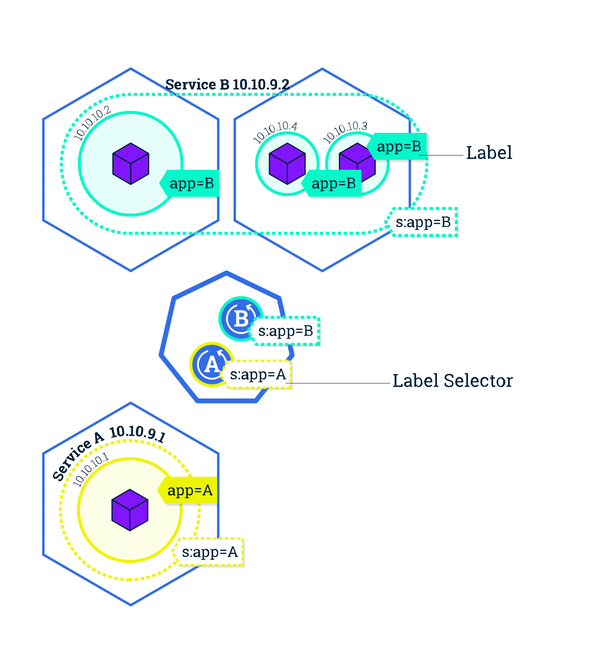
Services
Expose your app publicly
Uses labels and selectors

Slide 8
Azure functions in AKS
Add serverless capabilities with Virtual Nodes
Scale Event driven applications with KEDA (preview)
Scale HTTP driven applications with Osiris (experimental)

Slide 9
Azure functions in Kubernetes
The Bad news: You loose most of what you are used to with Azure funcions except:
Easy to write and small pieces of code
Triggers and bindings
Portable between all hosting options.

Slide 10
Dependency Injection

Slide 11
Dependency injection
Azure function V2
Microsoft.NET.Sdk.Functions >= 1.0.28
Loose the static (function class and methods)
Constructor injection!
Same as DI in ASP.Net core
Already provided services:
Microsoft.Extensions.Configuration.IConfiguration
Microsoft.Azure.WebJobs.Host.Executors.IHostIdProvider

Slide 12
DI - scopes
3 scopes:
Singleton – Created once, on first request or when created before registration.
Scoped – Created once per client request (connection).
Trancient – created on each request.
See https://docs.microsoft.com/en-us/aspnet/core/fundamentals/dependency-injection

Slide 13
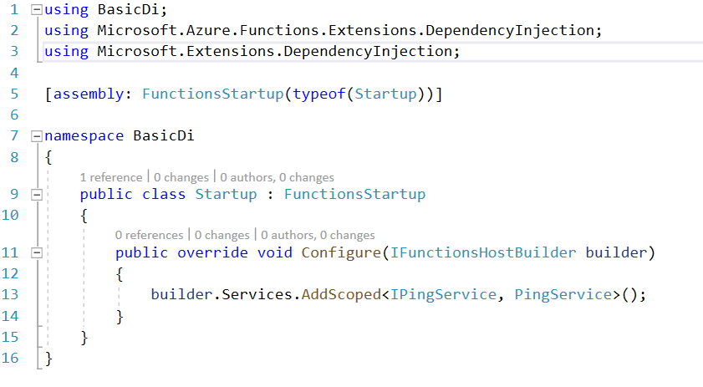
DI extension
NuGet: Microsoft.Azure.Functions.Extensions
Makes dependency registrations easier
Provides IServiceCollection on IFunctionHostBuilder

Slide 14

DI - HttpClient
Plain HttpClient
NamedHttpClient
Preconfigure
Set retry policies (Polly)

Slide 15
Functions in AKS

Slide 16
Dependency injection
Azure function V2
Microsoft.NET.Sdk.Functions >= 1.0.28
Loose the static (function class and methods)
Constructor injection!
Same as DI in ASP.Net core
Already provided services:
Microsoft.Extensions.Configuration.IConfiguration
Microsoft.Azure.WebJobs.Host.Executors.IHostIdProvider

